Slide 1
CS6303 DISTRIBUTED SYSTEMS
WOMEN SAFETY APPLICATION
SURIYAA V / 2020503550
SURYA CHARAN P / 2020503033

Slide 2
PROBLEM STATEMENT
The safety and security of women continue to be a pressing concern in today's society. Women face various risks, including harassment, violence, and discrimination, which hinder their ability to live freely and confidently. Existing safety measures and resources are often fragmented and lack integration, making it challenging for women to access timely assistance in emergencies. Additionally, the lack of awareness about women's safety laws and self-defense techniques further exacerbates the problem. Therefore, there is a critical need for a comprehensive women safety application that leverages the power of technology to provide women with a reliable and user-friendly tool for immediate help, information, and empowerment. This project aims to develop such an application, utilizing Android Studio, Java, and XML, to address the multifaceted challenges faced by women in terms of safety and security.

Slide 3
OBJECTIVES
Shake Detector: Implement a robust shake detection mechanism that can sense sudden movements of the mobile device, triggering immediate actions in emergency situations.
Siren Sound: Integrate a high-pitched siren sound within the application to grab immediate attention and deter potential threats.
Panic Button with Call Functionality: Incorporate a prominent panic button that, when pressed, automatically initiates a call to the user's registered emergency contact number, ensuring immediate help in critical situations.
Shake Device for SOS and Siren: Enable users to activate the SOS feature by vigorously shaking their mobile device, which will not only send distress messages to registered contacts but also emit a loud siren sound to alert nearby individuals.
Last Known Location Sharing: Implement a feature that automatically captures and shares the user's last known location with registered emergency contacts, enabling them to track the user's whereabouts in case of an emergency.

Slide 4
Multiple Emergency Contacts: Allow users to add and manage multiple emergency contacts within the application, ensuring a wider network of support in times of distress.
Find Nearby Police Stations and Hospitals: Integrate a location-based feature that helps users find the nearest police stations and hospitals, providing them with immediate access to emergency services.
Women Safety Laws: Provide a comprehensive repository of women safety laws to educate and empower users with knowledge about their rights and legal protections.
Self-Defense Video: Include a short self-defense video within the application to equip users with basic self-defense techniques and strategies that can be utilized during emergency situations.
Direct Calling to National Helplines: Facilitate direct calling to six national helpline numbers related to women safety, enabling users to seek immediate assistance from the appropriate authorities.

Slide 5
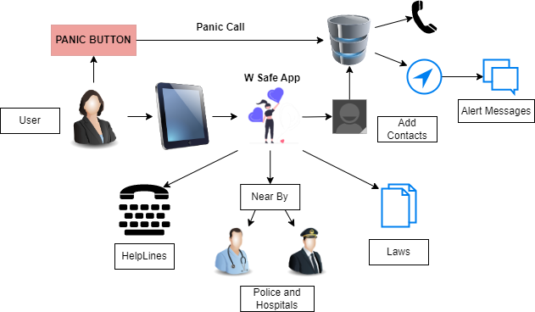
SYSTEM ARCHITECTURE

Slide 6
TOOLS REQUIRED
Android Studio: The primary development environment for creating Android applications.
Java: The programming language used for Android application development.
Shake Detector: A mechanism to detect and respond to sudden movements or shakes of the mobile device.
GPS: Global Positioning System technology used to determine the device's geographic location.

Slide 7
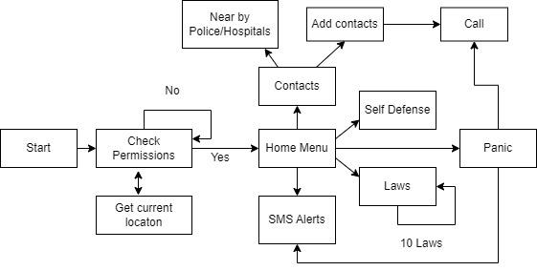
FLOW DIAGRAM

Slide 8
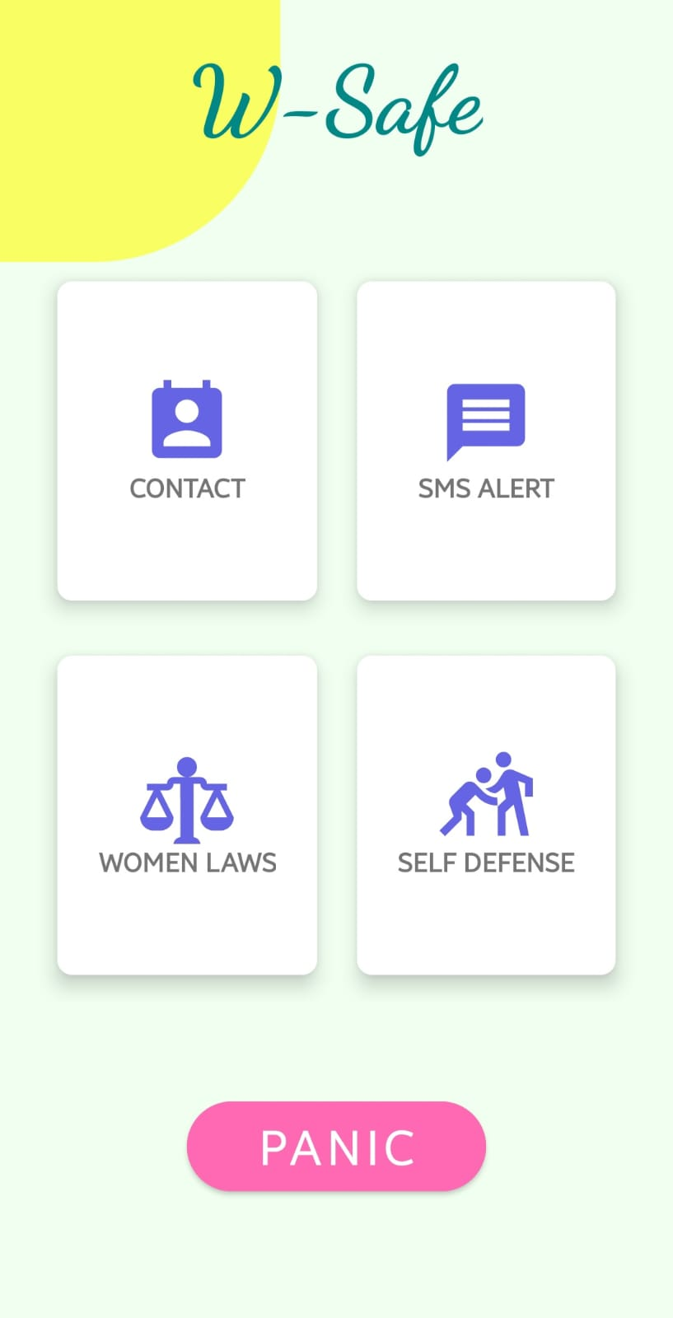
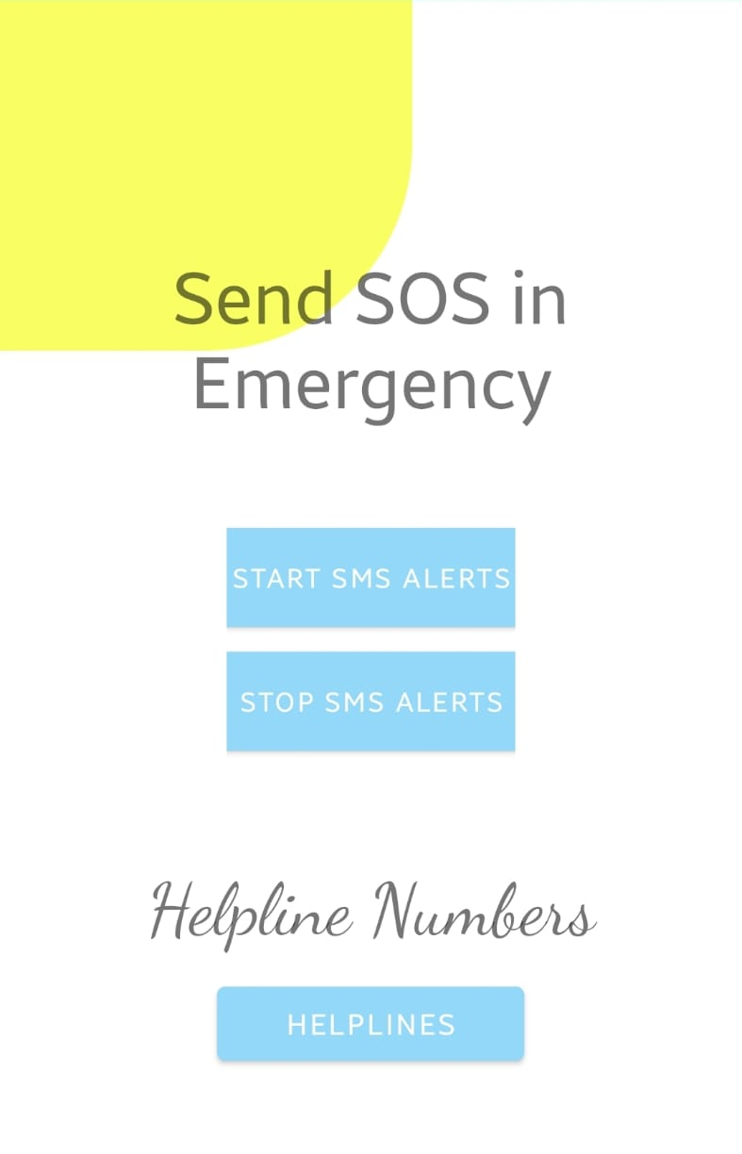
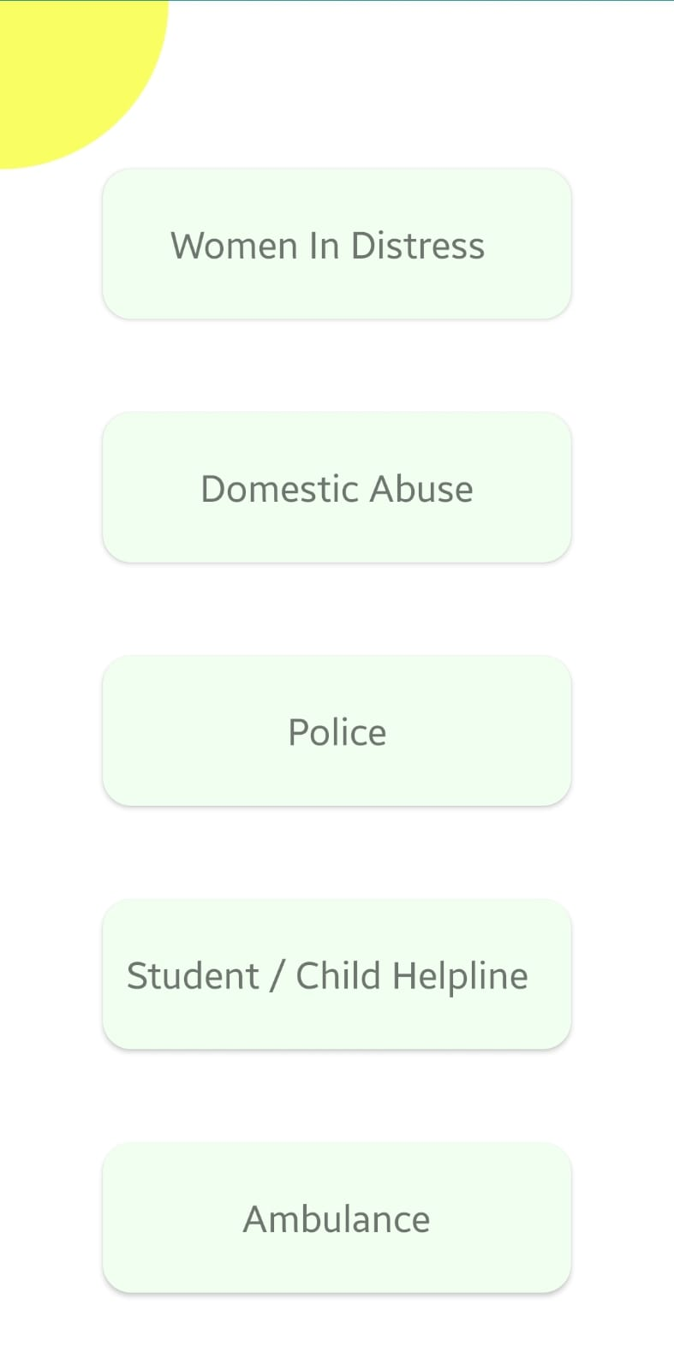
OUTPUT

Slide 9
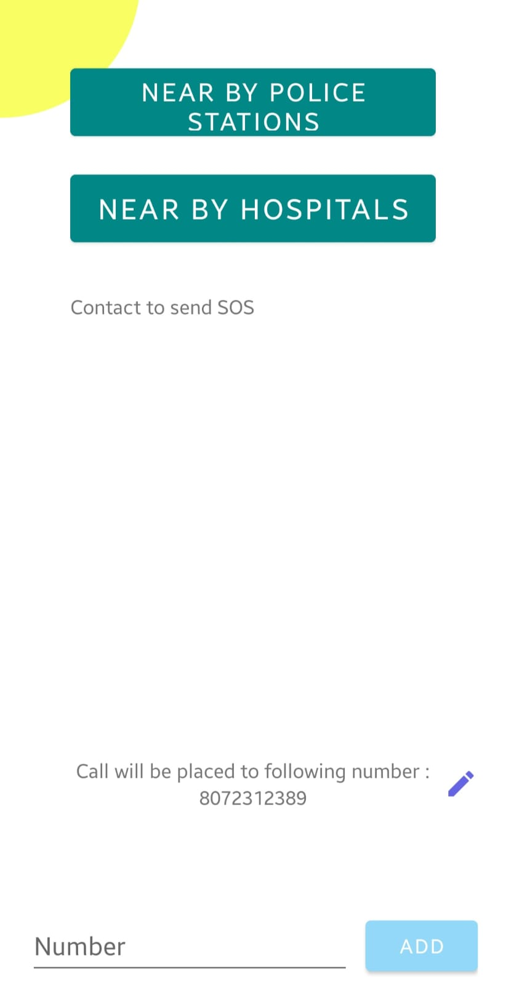
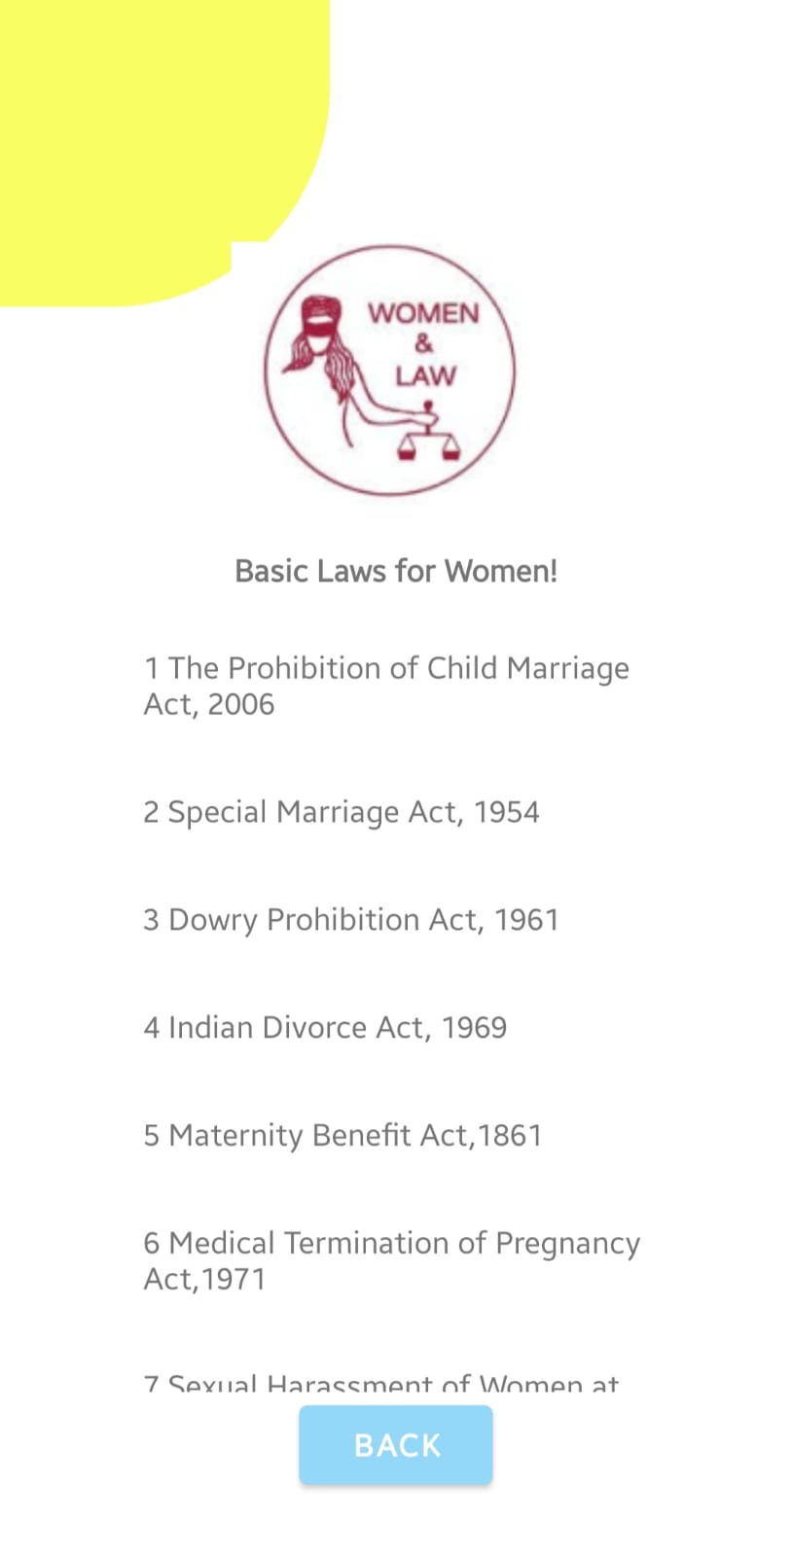
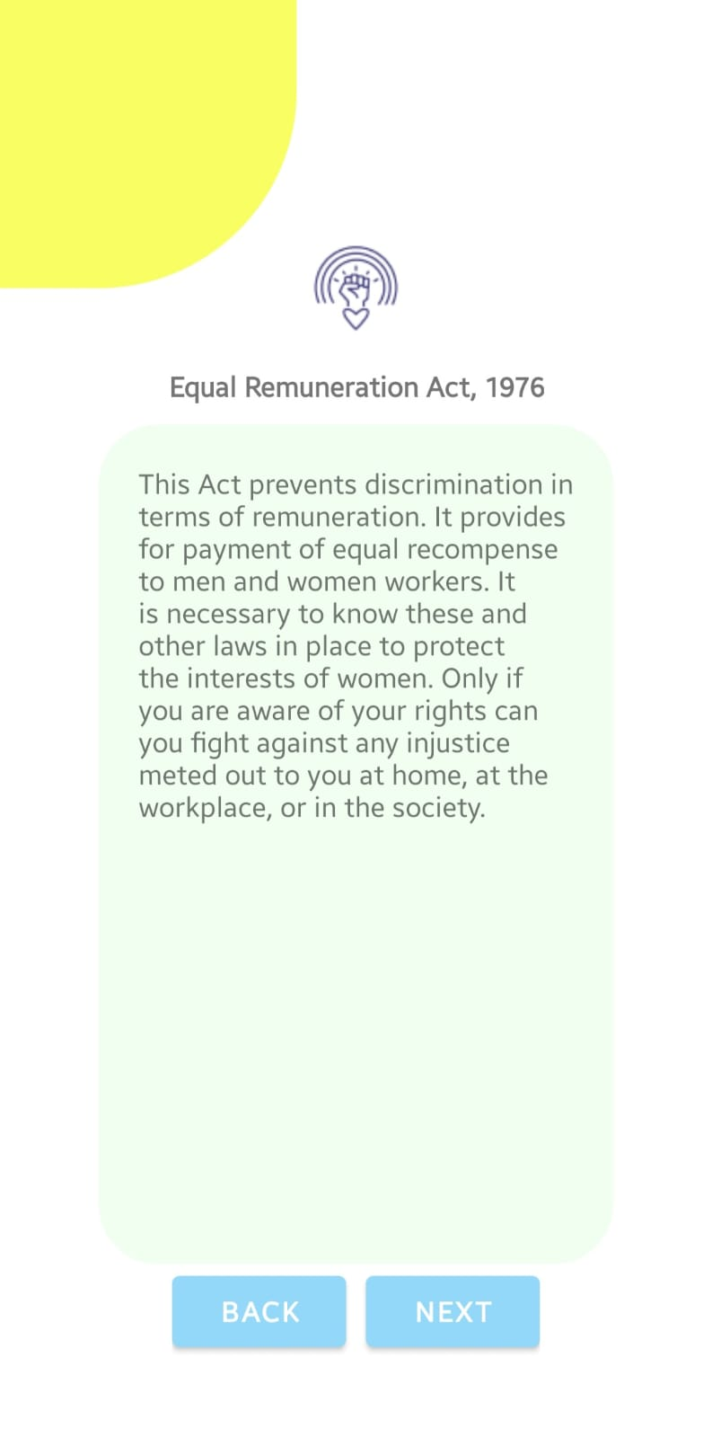
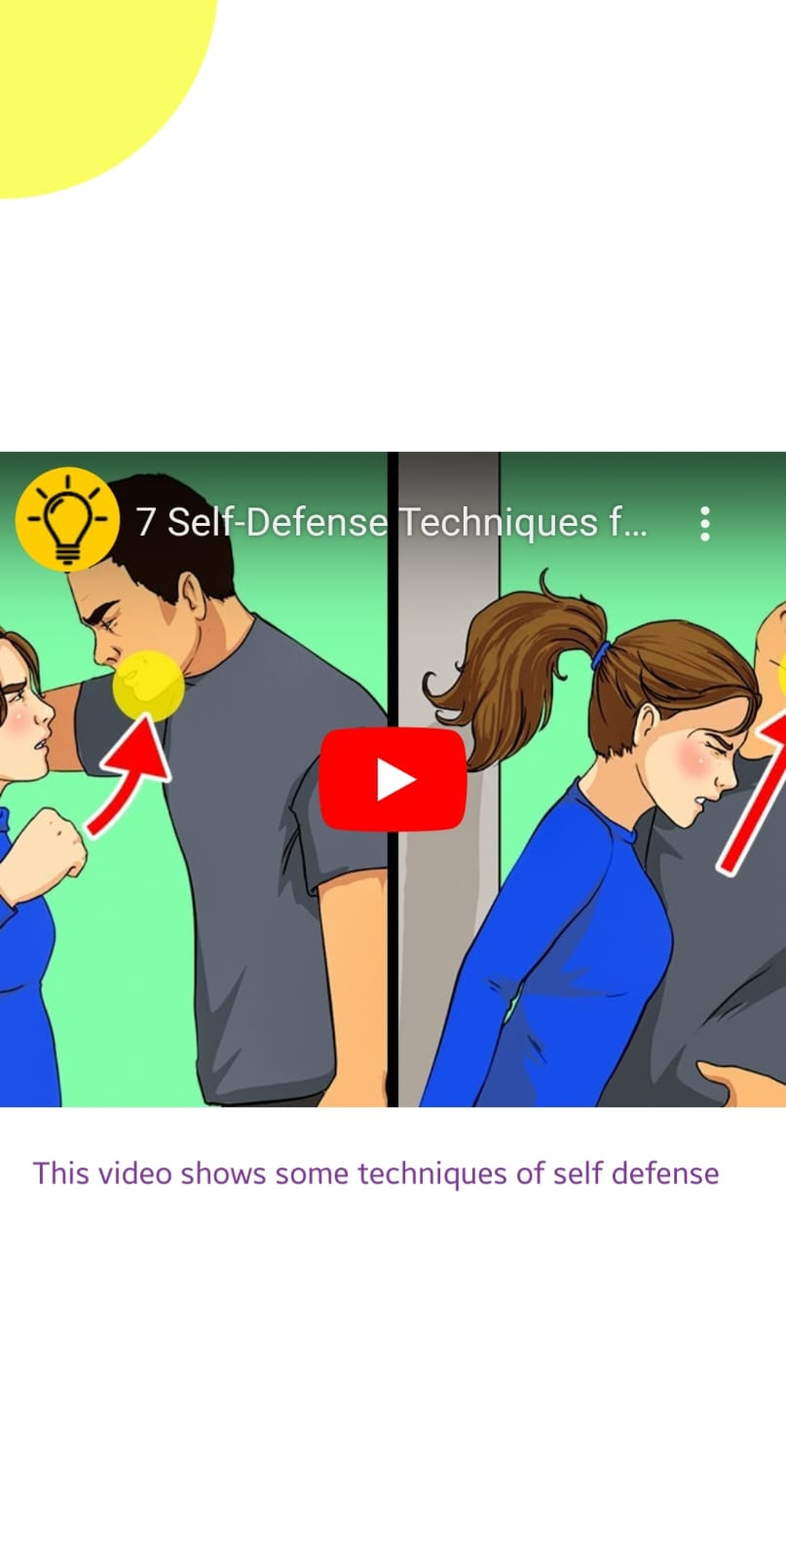

Slide 10


